Slide 1
Canny Edge Detector
Smooth image with a Gaussian
  optimizes the trade-off between noise filtering and edge localization
Compute the Gradient magnitude using approximations of partial derivatives
  2x2 filters
Thin edges by applying non-maxima suppression to the gradient magnitude
Detect edges by double thresholding
Canny Edge Detector
Notes:
Euripides G.M. Petrakis

Slide 2

Smooth with Gaussian
Canny Edge Detector

Slide 3
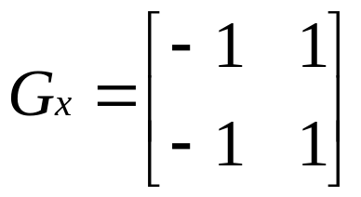
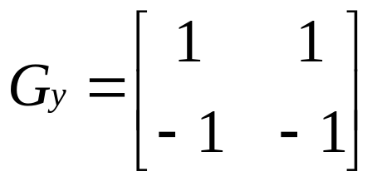
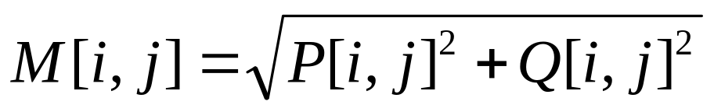
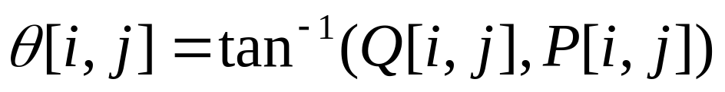
Gradient
At each point convolve with
magnitude and orientation of the Gradient are computed as
Avoid floating point arithmetic for fast computation
Canny Edge Detector

Slide 4
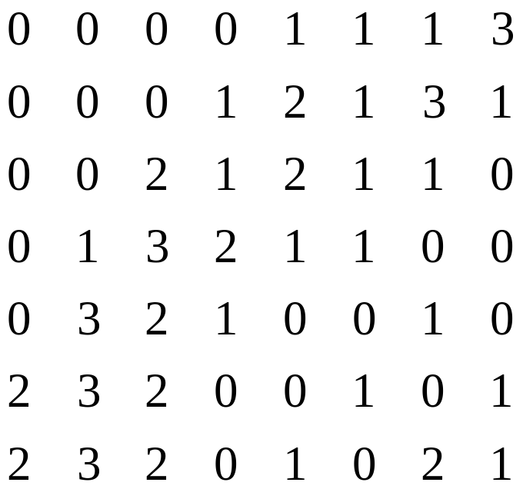
Non-Maxima Suppression
Thin edges by keeping large values of Gradient
  not always at the location of an edge
  there are many thick edges
Canny Edge Detector
Notes:
Euripides G.M. Petrakis

Slide 5
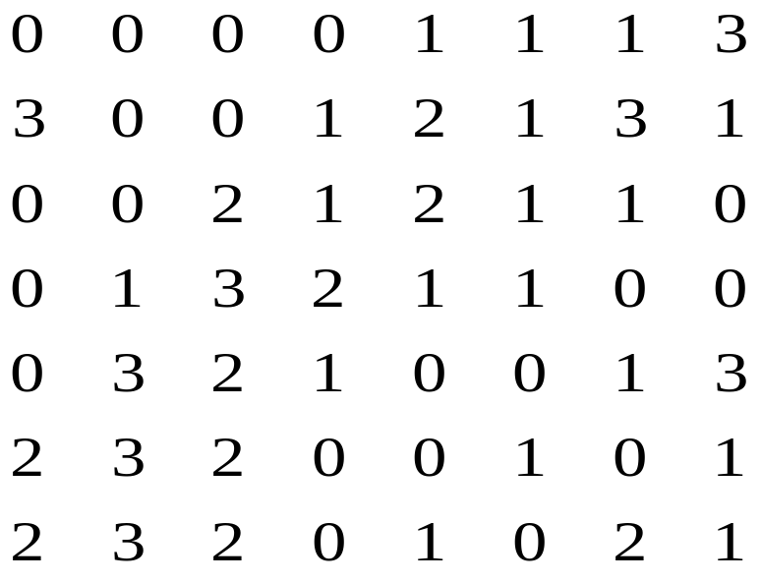
Non-Maxima Suppression (2)
Thin the broad ridges in M[i,j] into ridges that are only one pixel wide
Find local maxima in M[i,j] by suppressing all values along the line of the Gradient that are not peak values of the ridge
false
edges
gaps
Canny Edge Detector

Slide 6
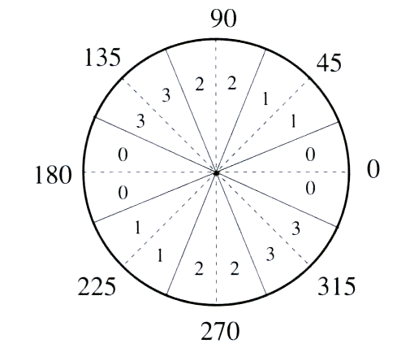
Gradient Orientation
Reduce angle of Gradient θ[i,j] to one of the 4 sectors
Check the 3x3 region of each M[i,j]
If the value at the center is not greater than the 2 values along the gradient, then M[i,j] is set to 0
Canny Edge Detector

Slide 7
0
0
0
0
1
1
1
3
local
maxima
0
0
0
1
2
1
3
1
0
0
2
1
2
1
1
0
removed
0
1
3
2
1
1
0
0
0
3
2
1
0
0
1
0
depends
on condition
2
3
2
0
0
1
0
1
2
3
2
0
1
0
2
1
Canny Edge Detector

Slide 8
0
0
0
0
0
0
0
3
0
0
0
0
2
1
3
0
0
0
2
1
2
0
0
0
0
0
3
0
0
0
0
0
false edges
0
3
2
0
0
0
0
0
0
3
0
0
0
1
0
1
0
3
0
0
1
0
2
0
The suppressed magnitude image will contain many false edges caused by noise or fine texture
Canny Edge Detector

Slide 9
Thresholding
Reduce number of false edges by applying a threshold T
  all values below T are changed to 0
  selecting a good values for T is difficult
  some false edges will remain if T is too low
  some edges will disappear if T is too high
  some edges will disappear due to softening of the edge contrast by shadows
Canny Edge Detector

Slide 10
Double Thresholding
Apply two thresholds in the suppressed image
  T₂ = 2T₂
  two images in the output
  the image from T₂ contains fewer edges but has gaps in the contours
  the image from T₁ has many false edges
  combine the results from T₁ and T₂
  link the edges of T₂ into contours until we reach a gap
  link the edge from T₂ with edge pixels from a T₁ contour until a T₂ edge is found again
Canny Edge Detector

Slide 11
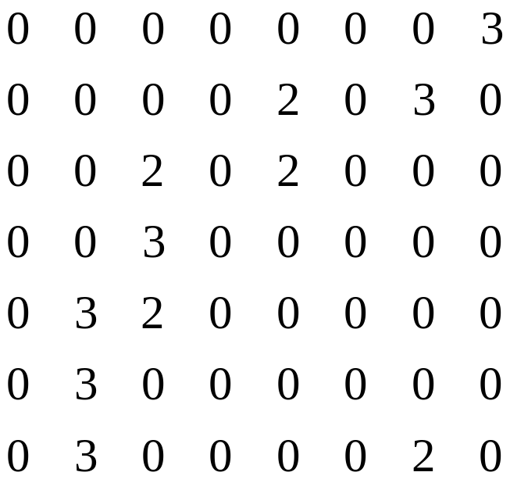
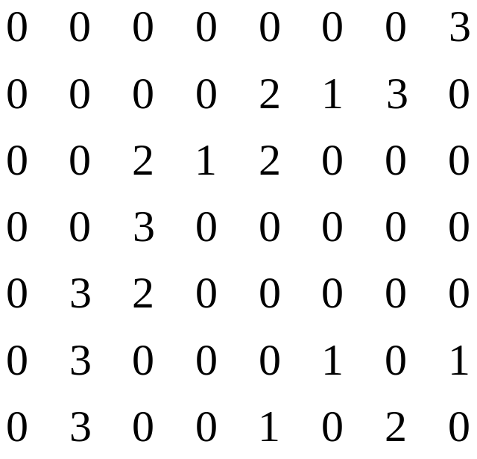
T₂=2
T₁=1
gaps
filled
from
T₁
A T₂ contour has pixels along the green arrows
Linking: search in a 3x3 of each pixel and connect the
pixel at the center with the one having greater value
Search in the direction of the edge (direction of Gradient)
Canny Edge Detector

Slide 12
Line Detection
Model of a line: two edges with opposite polarity in distance less than the size of the smoothing filter
  edge detection filters respond to step edges
  they do not provide meaningful response to lines
Apply nonmaxima suppression on the smoothed output
  a line is the derivative of a step ➔ the derivative step of the Canny algorithm is not necessary
Canny Edge Detector

Slide 13
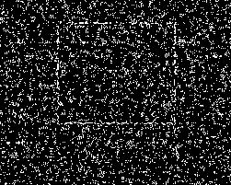
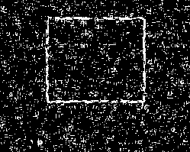
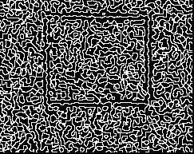

Stages of canny edge detection
Canny Edge Detector

